Slide 1
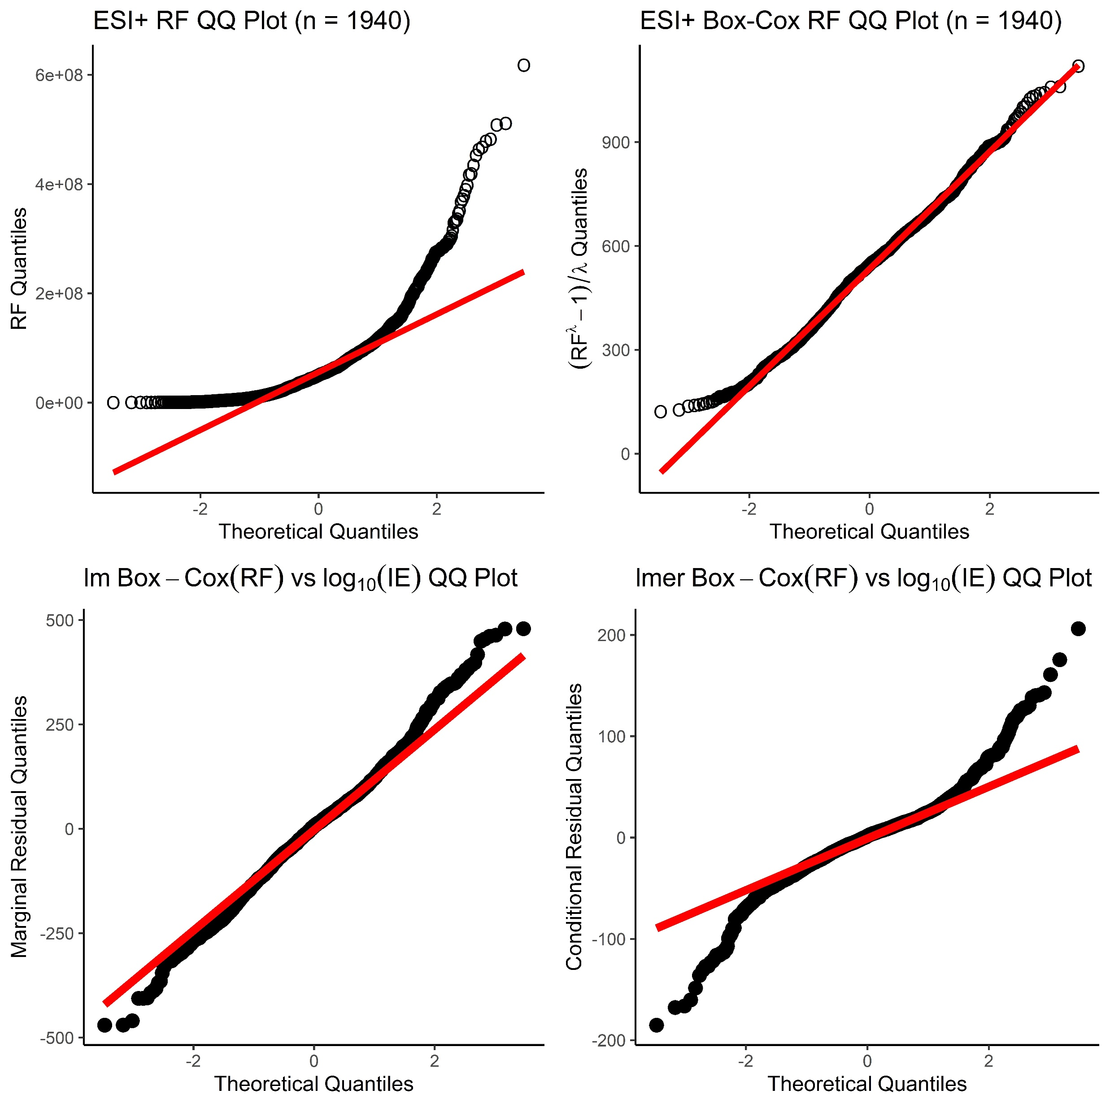
(A)
(B)
(C)
(D)
Notes:
Figure SX: Normal QQ Plots of (A) the observed response factor distribution, (B) Box-Cox transformed response factor distribution, (C) marginal residuals resulting from the linear regression of Box-Cox transformed RF vs. log₁₀ Predicted Ionization Efficiency, and (D) conditional residuals resulting from the linear mixed-effects model regression of Box-Cox transformed RF vs. log₁₀ Predicted Ionization Efficiency for ENTACT ESI+ data. All Box-Cox transforms were performed using an optimum lambda = 0.285, as derived from bootstrap resampling and transforming the univariate RF distribution 50,000 times.

Slide 2
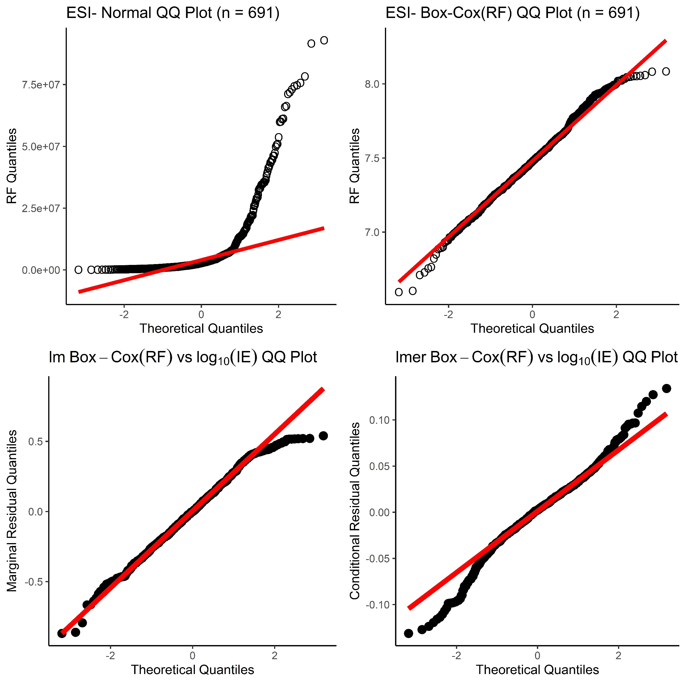
(A)
(B)
(C)
(D)
Notes:
Figure SX: Normal QQ Plots of (A) the observed response factor distribution, (B) Box-Cox transformed response factor distribution, (C) marginal residuals resulting from the linear regression of Box-Cox transformed RF vs. log₁₀ Predicted Ionization Efficiency, and (D) conditional residuals resulting from the linear mixed-effects model regression of Box-Cox transformed RF vs. log₁₀ Predicted Ionization Efficiency for ENTACT ESI- data. All Box-Cox transforms were performed using an optimum lambda = -0.106, as derived from bootstrap resampling and transforming the univariate RF distribution 50,000 times.

